Slide 1
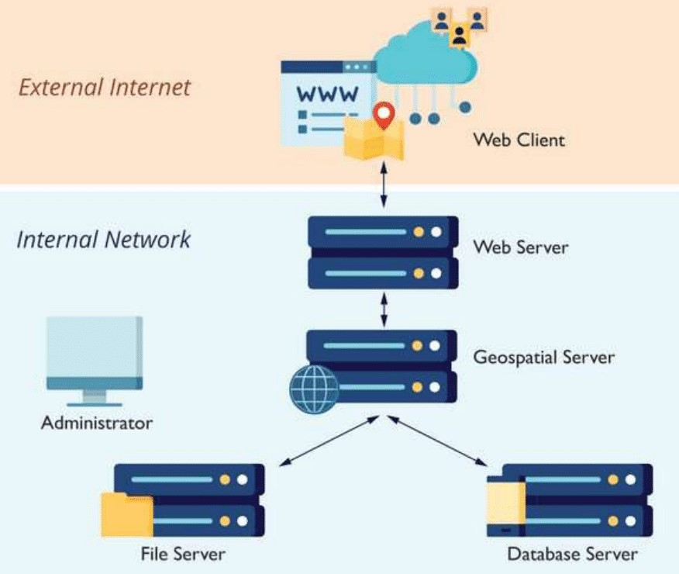
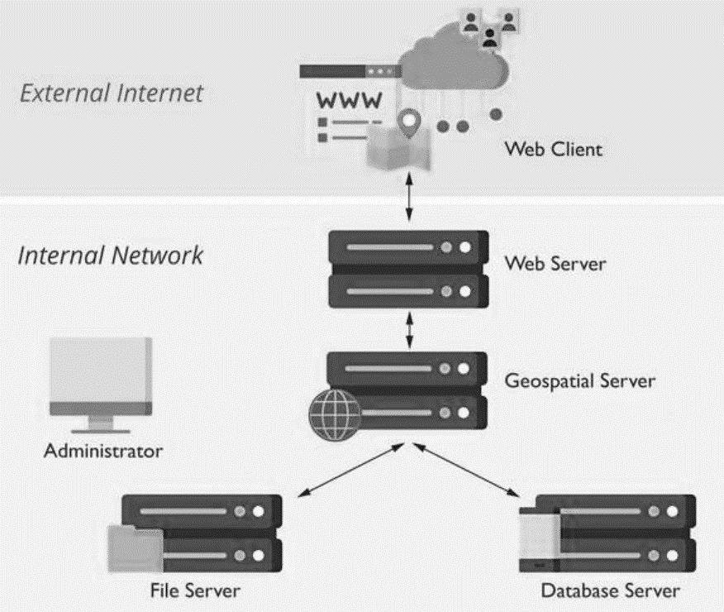
public audience
domain
web creators’
domain
ArcGIS
Research Files
Data Research

Slide 2
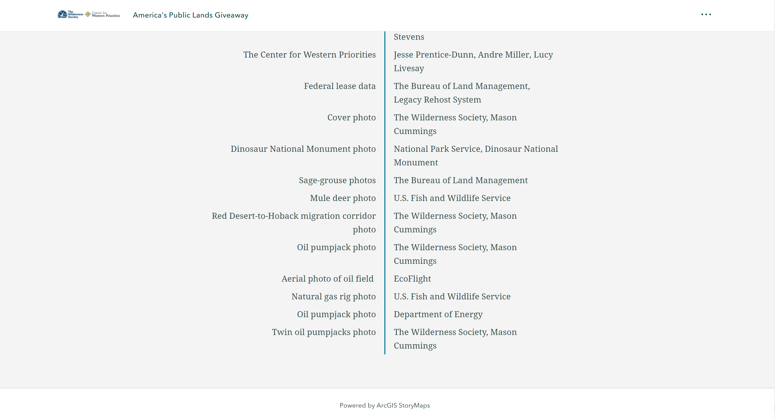

Slide 3
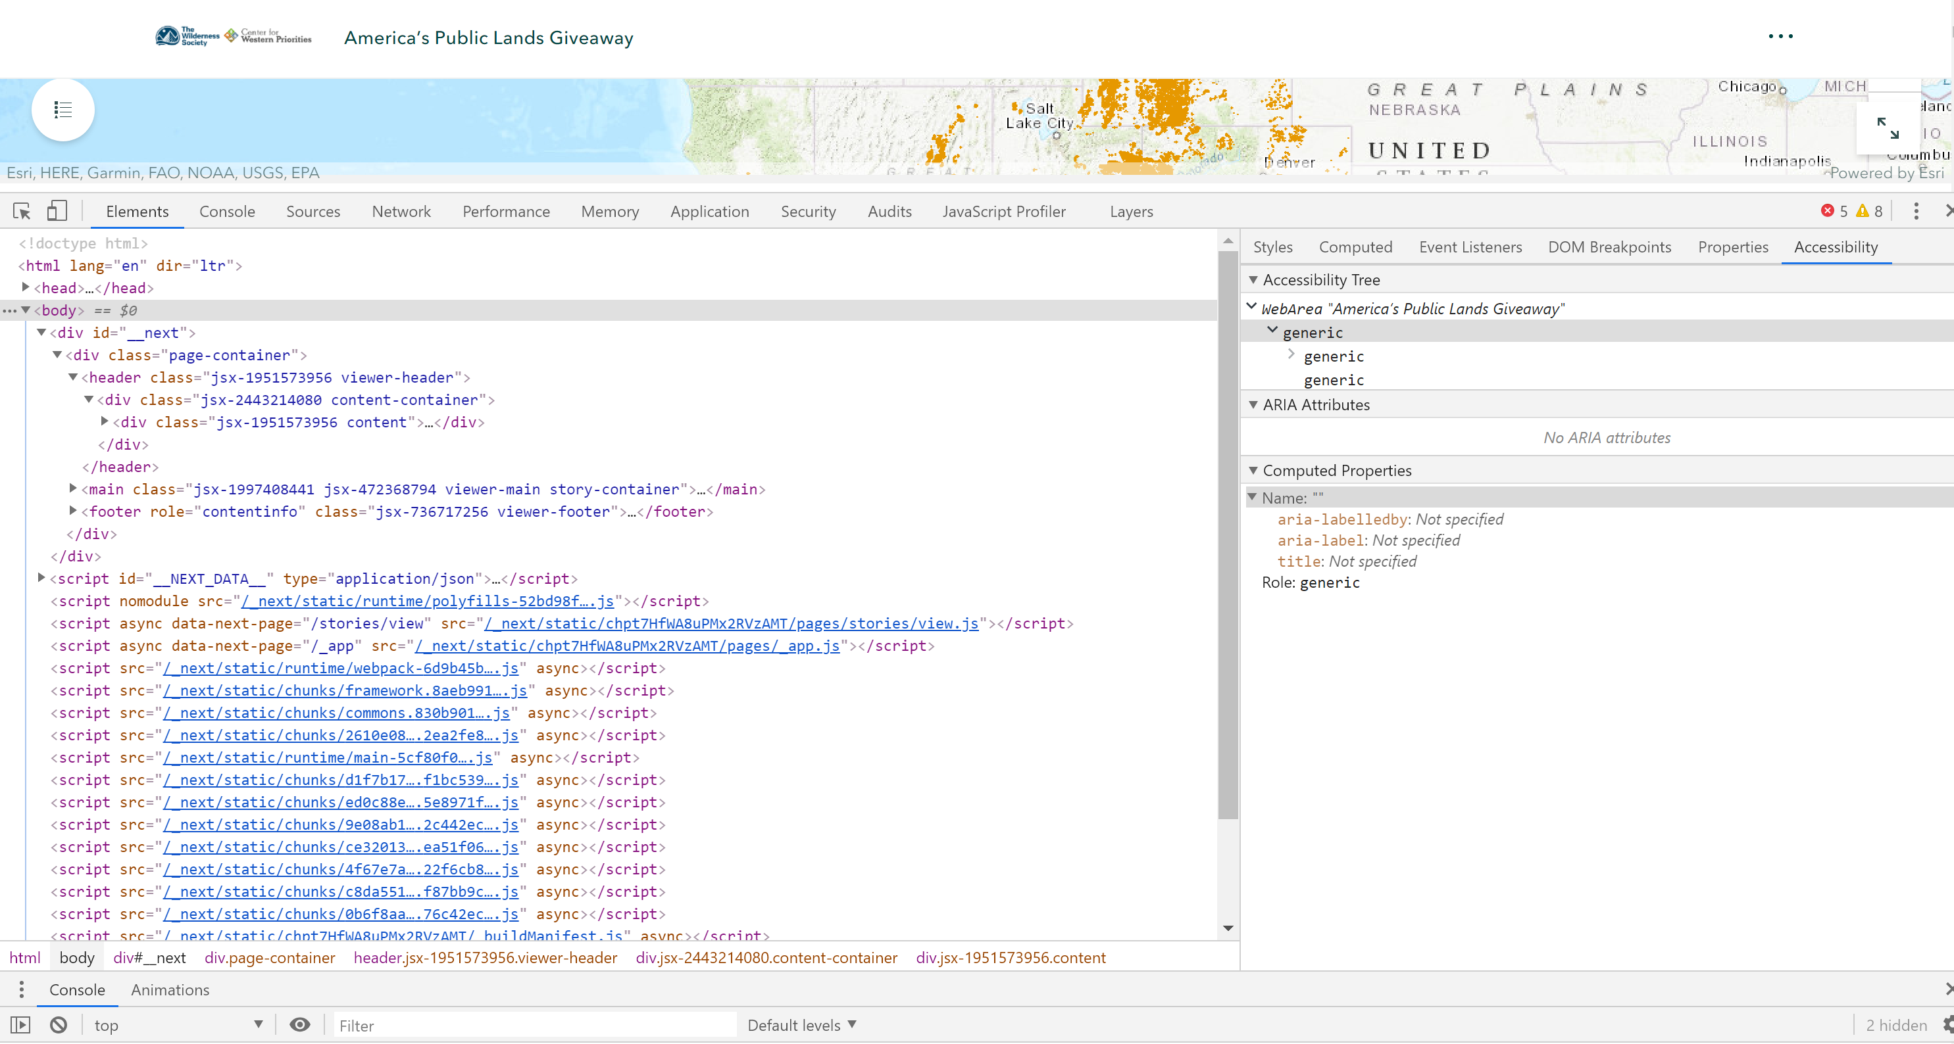

Slide 4
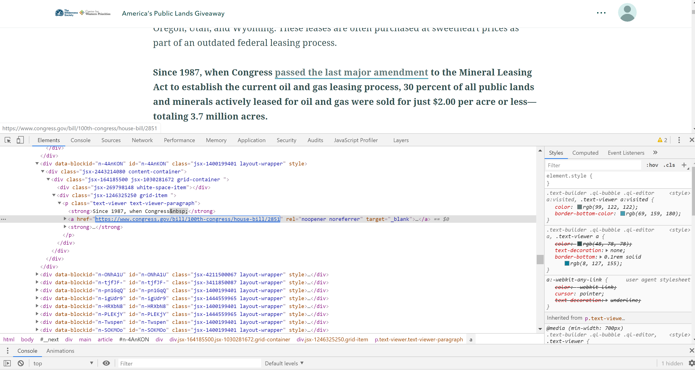

Slide 5
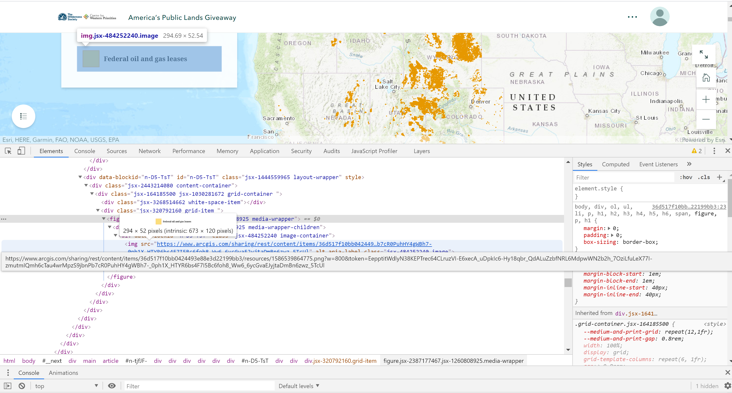

Slide 6
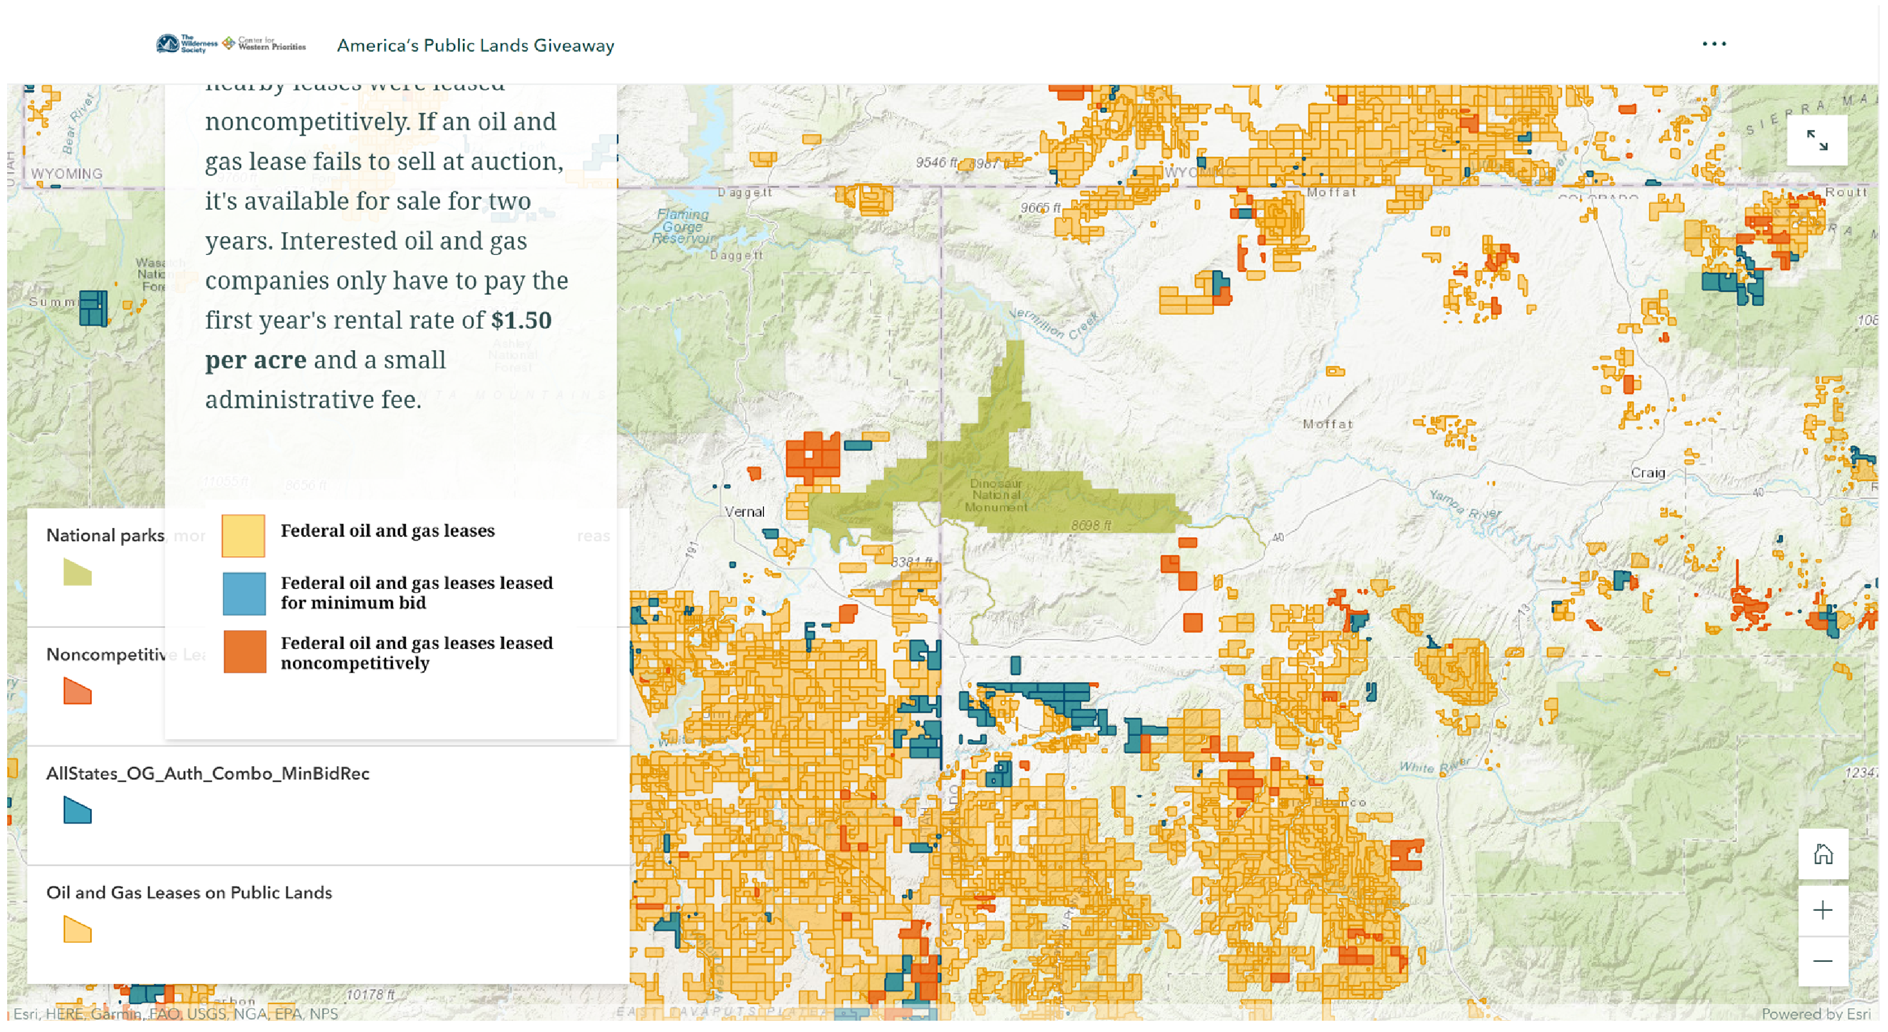
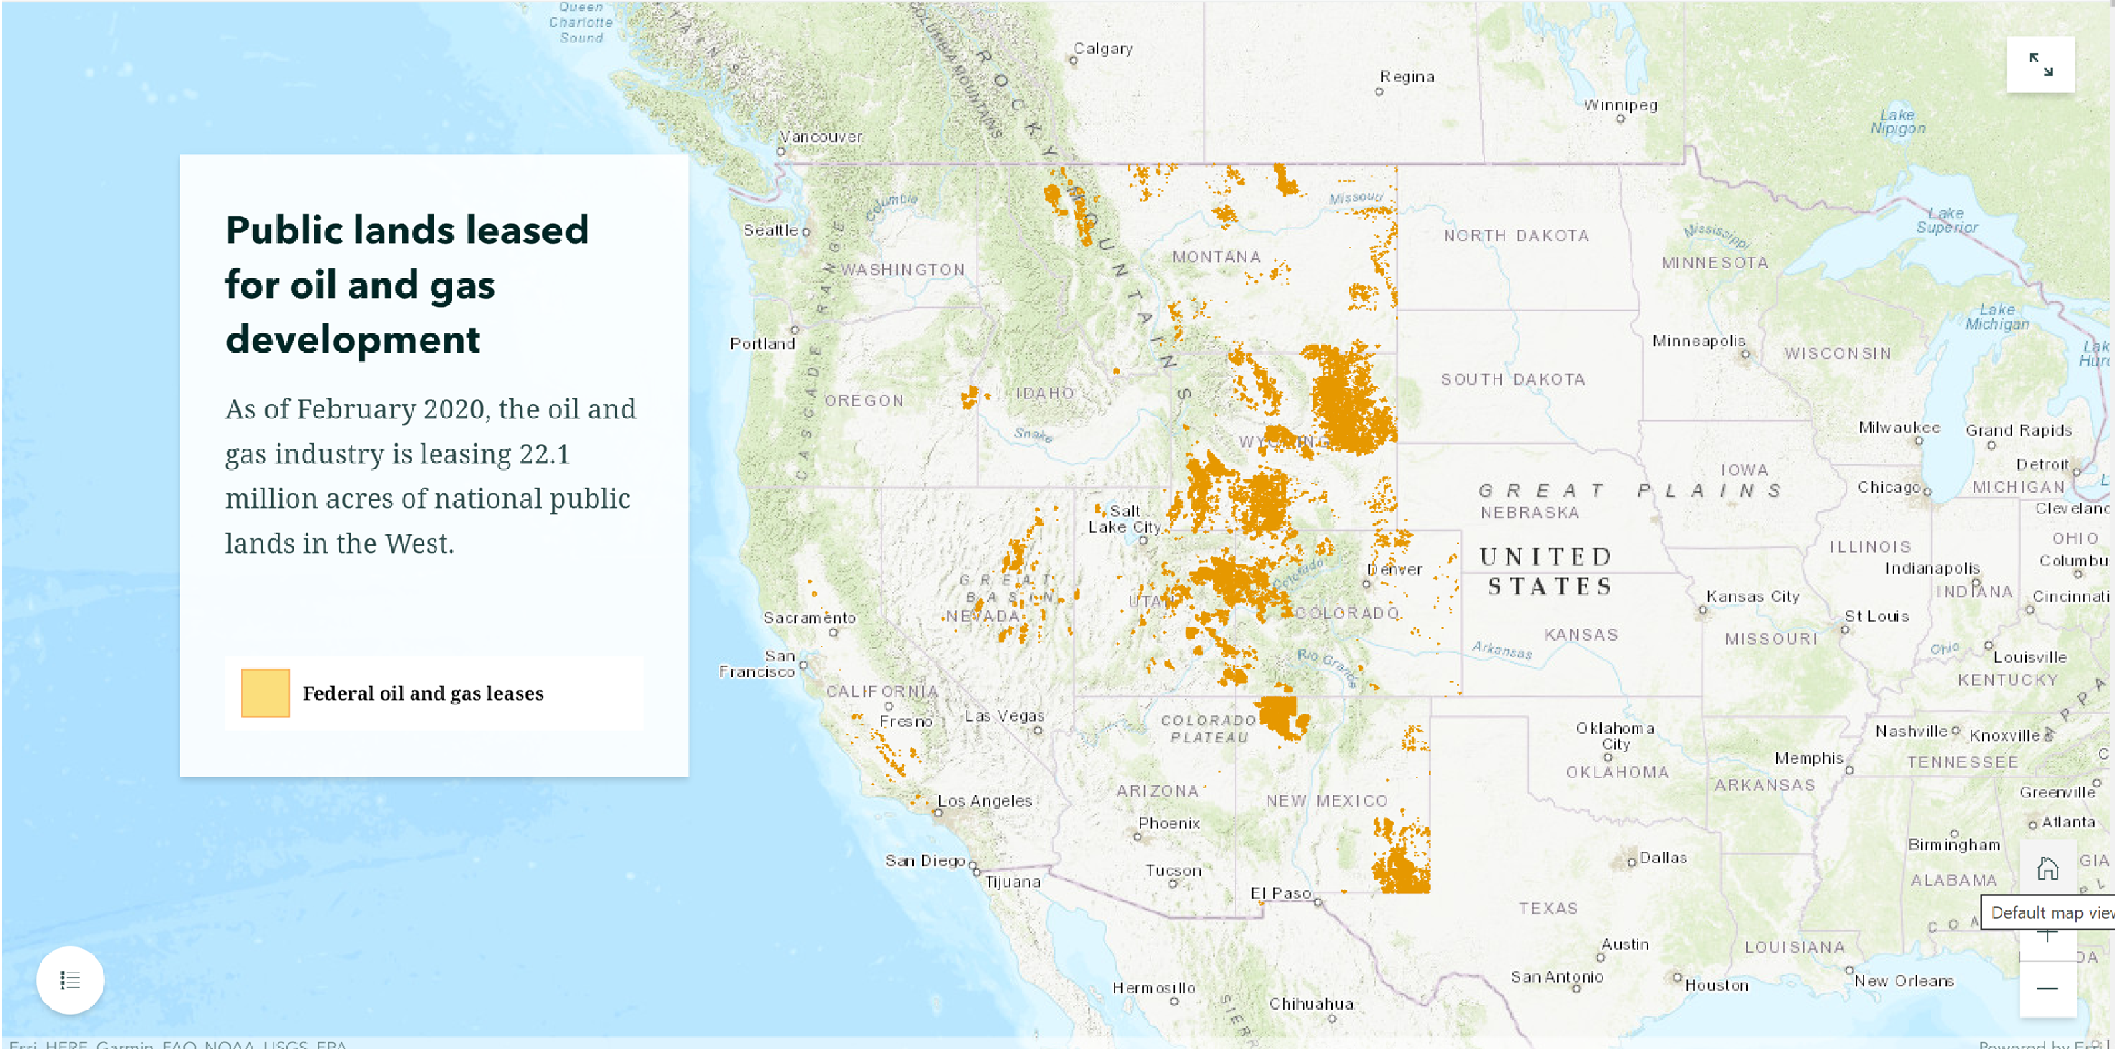
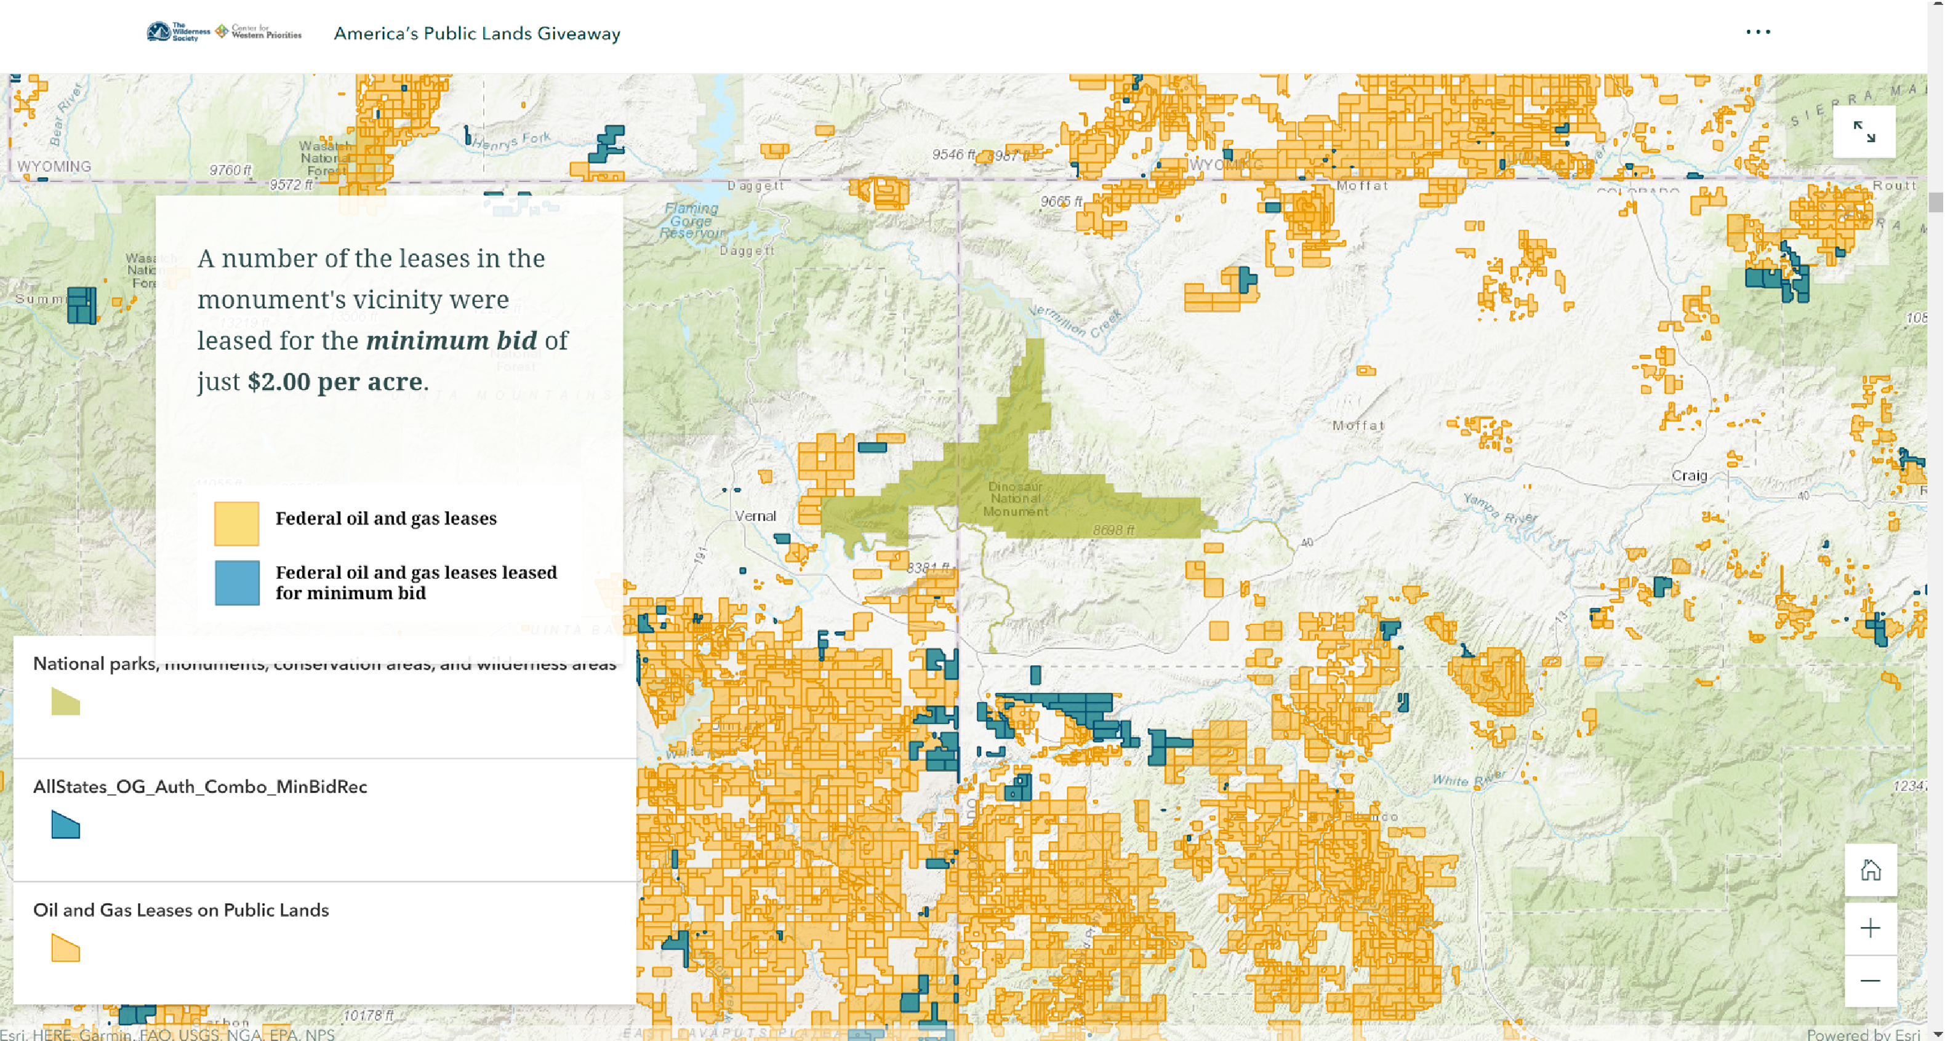
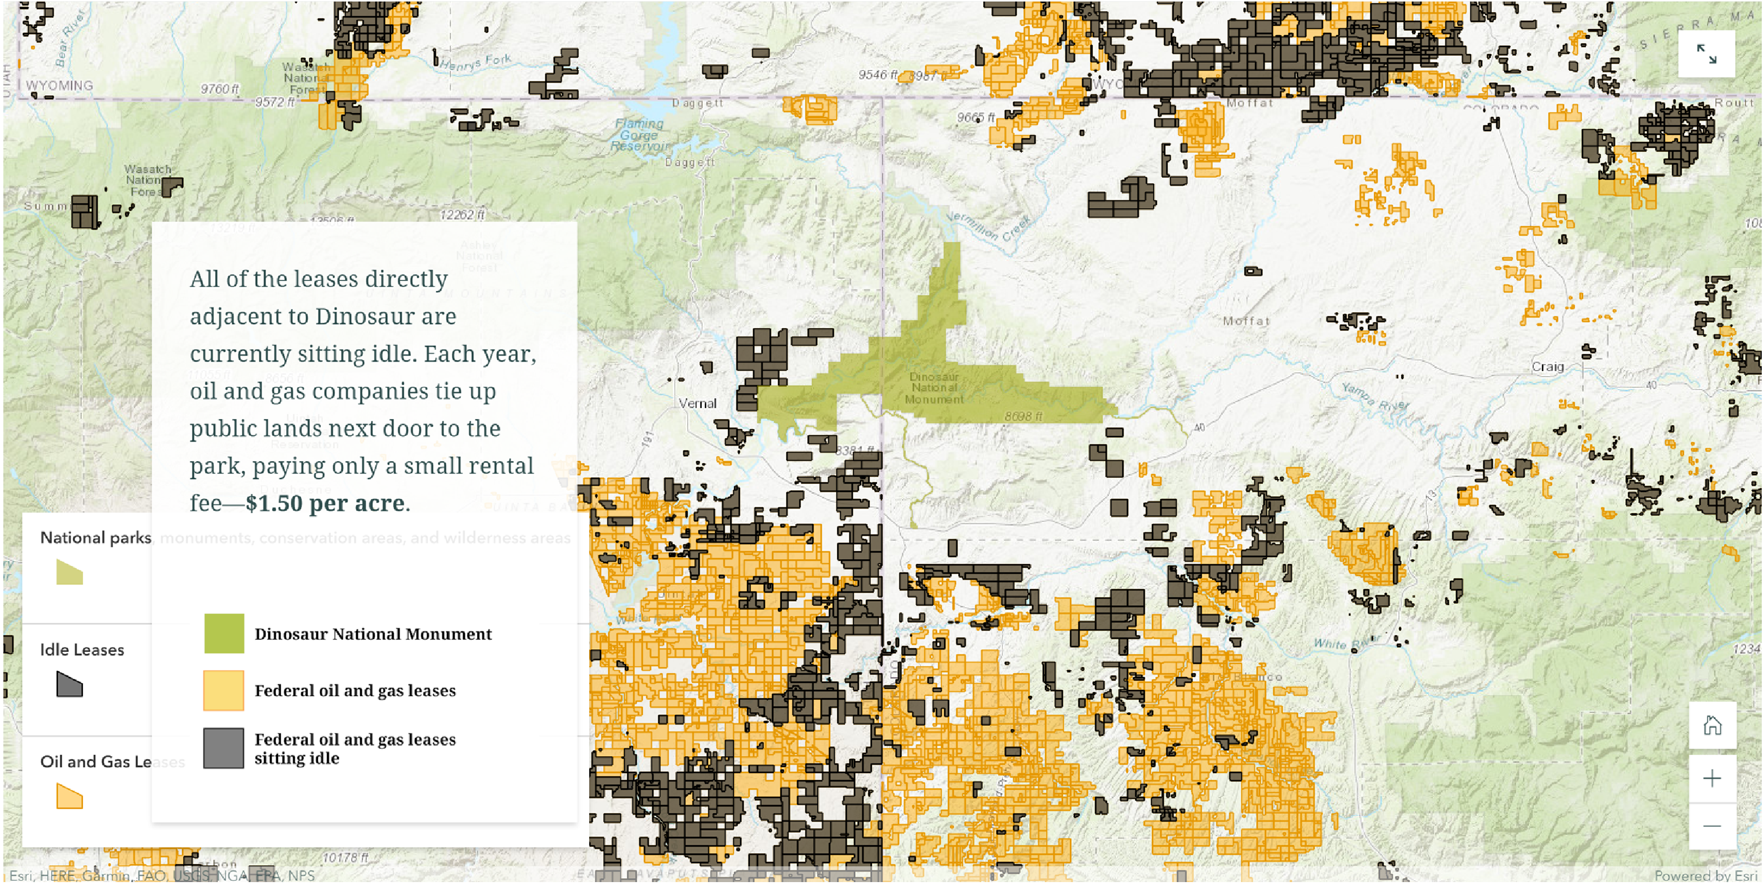
Notes:
The distribution of land with federal oil and gas leases leased for minimum bid ($2 per acre)
The distribution of land with federal oil and gas leases leased noncompetitively (below $2 per acre)
The location of Dinosaur National Monument which is located within the oil and gas industries sites offered by the U.S. government

Slide 7
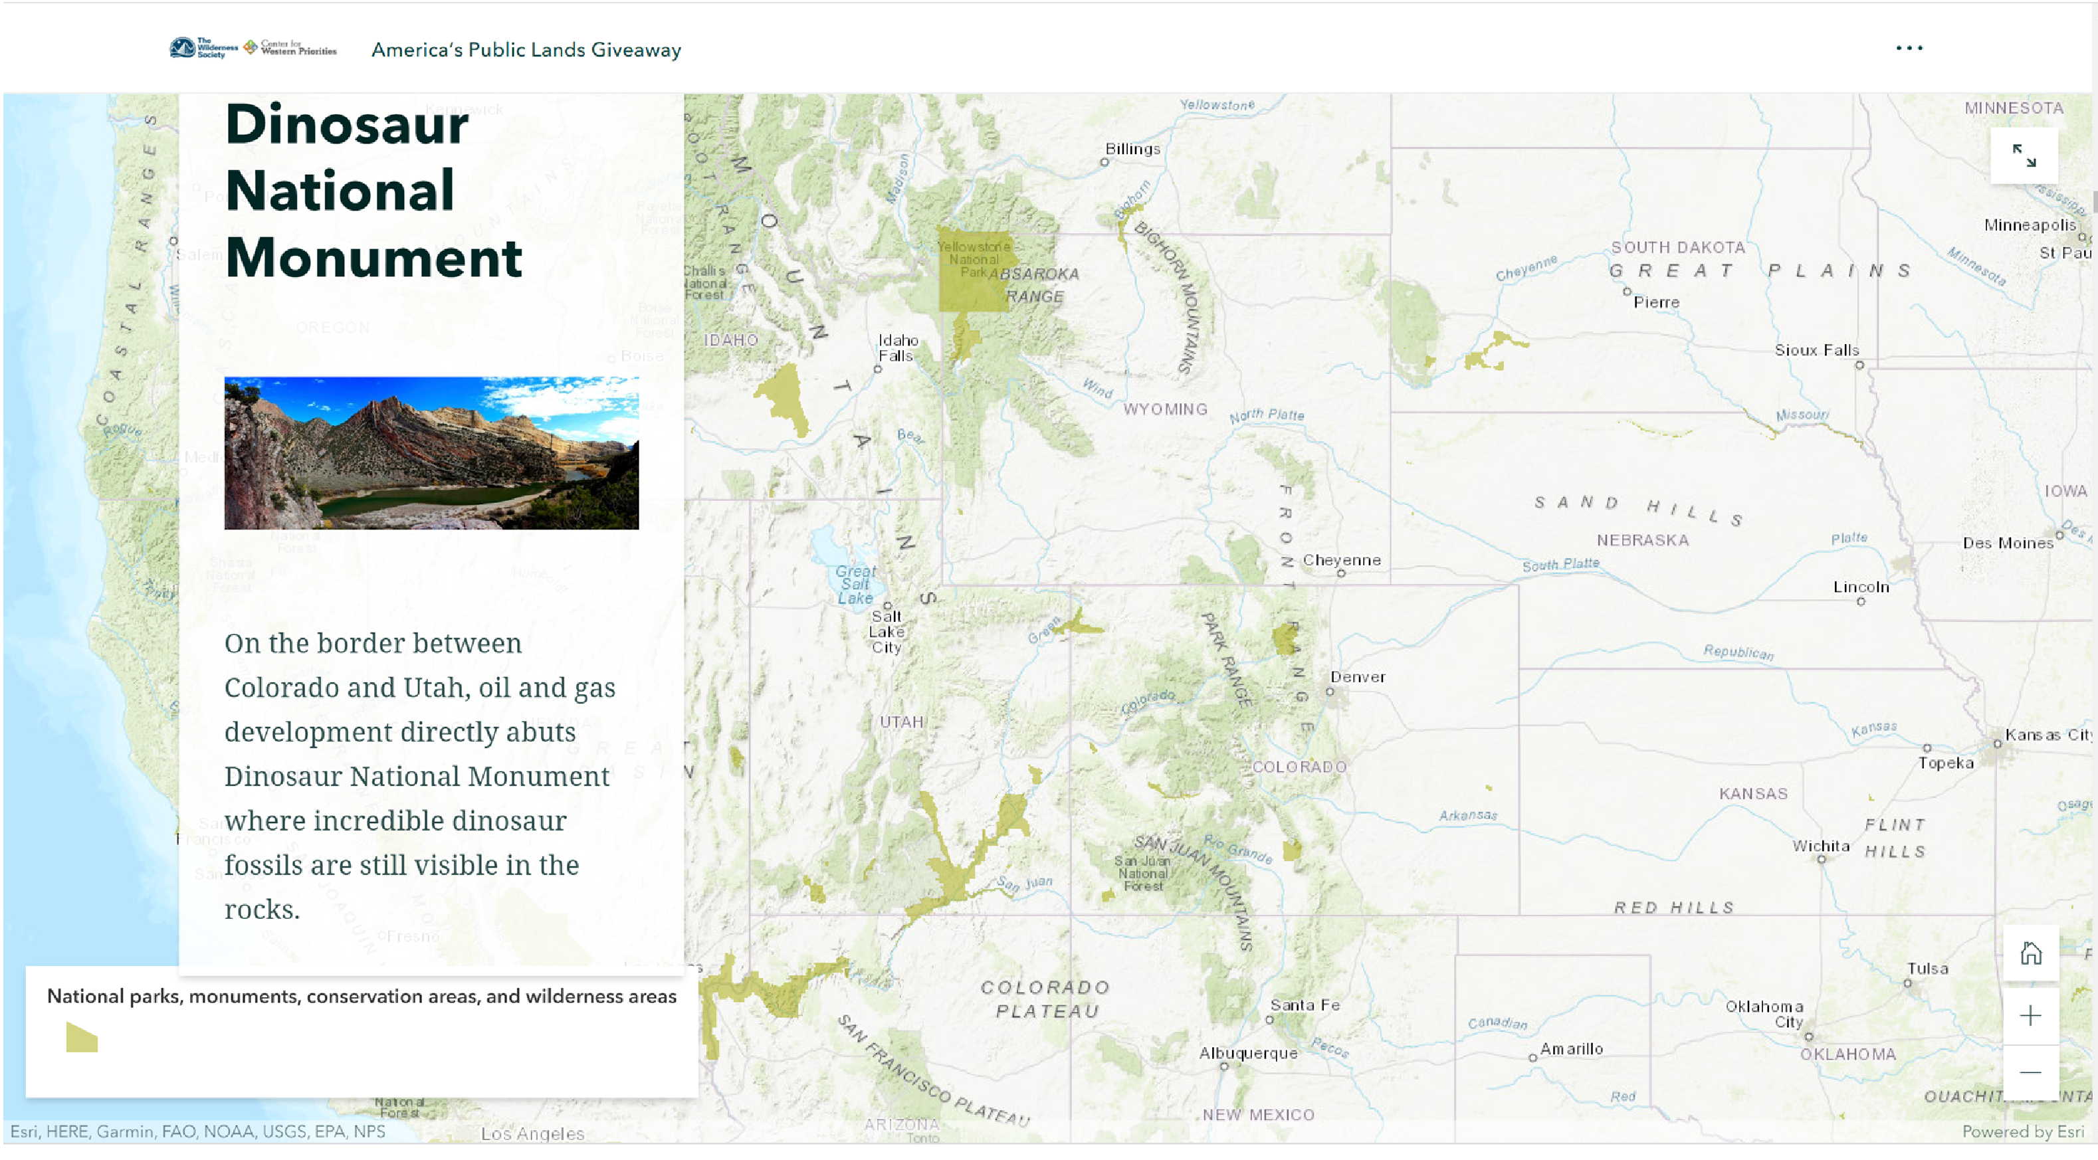
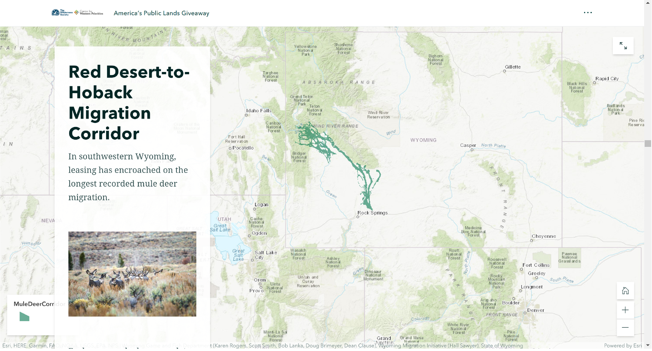
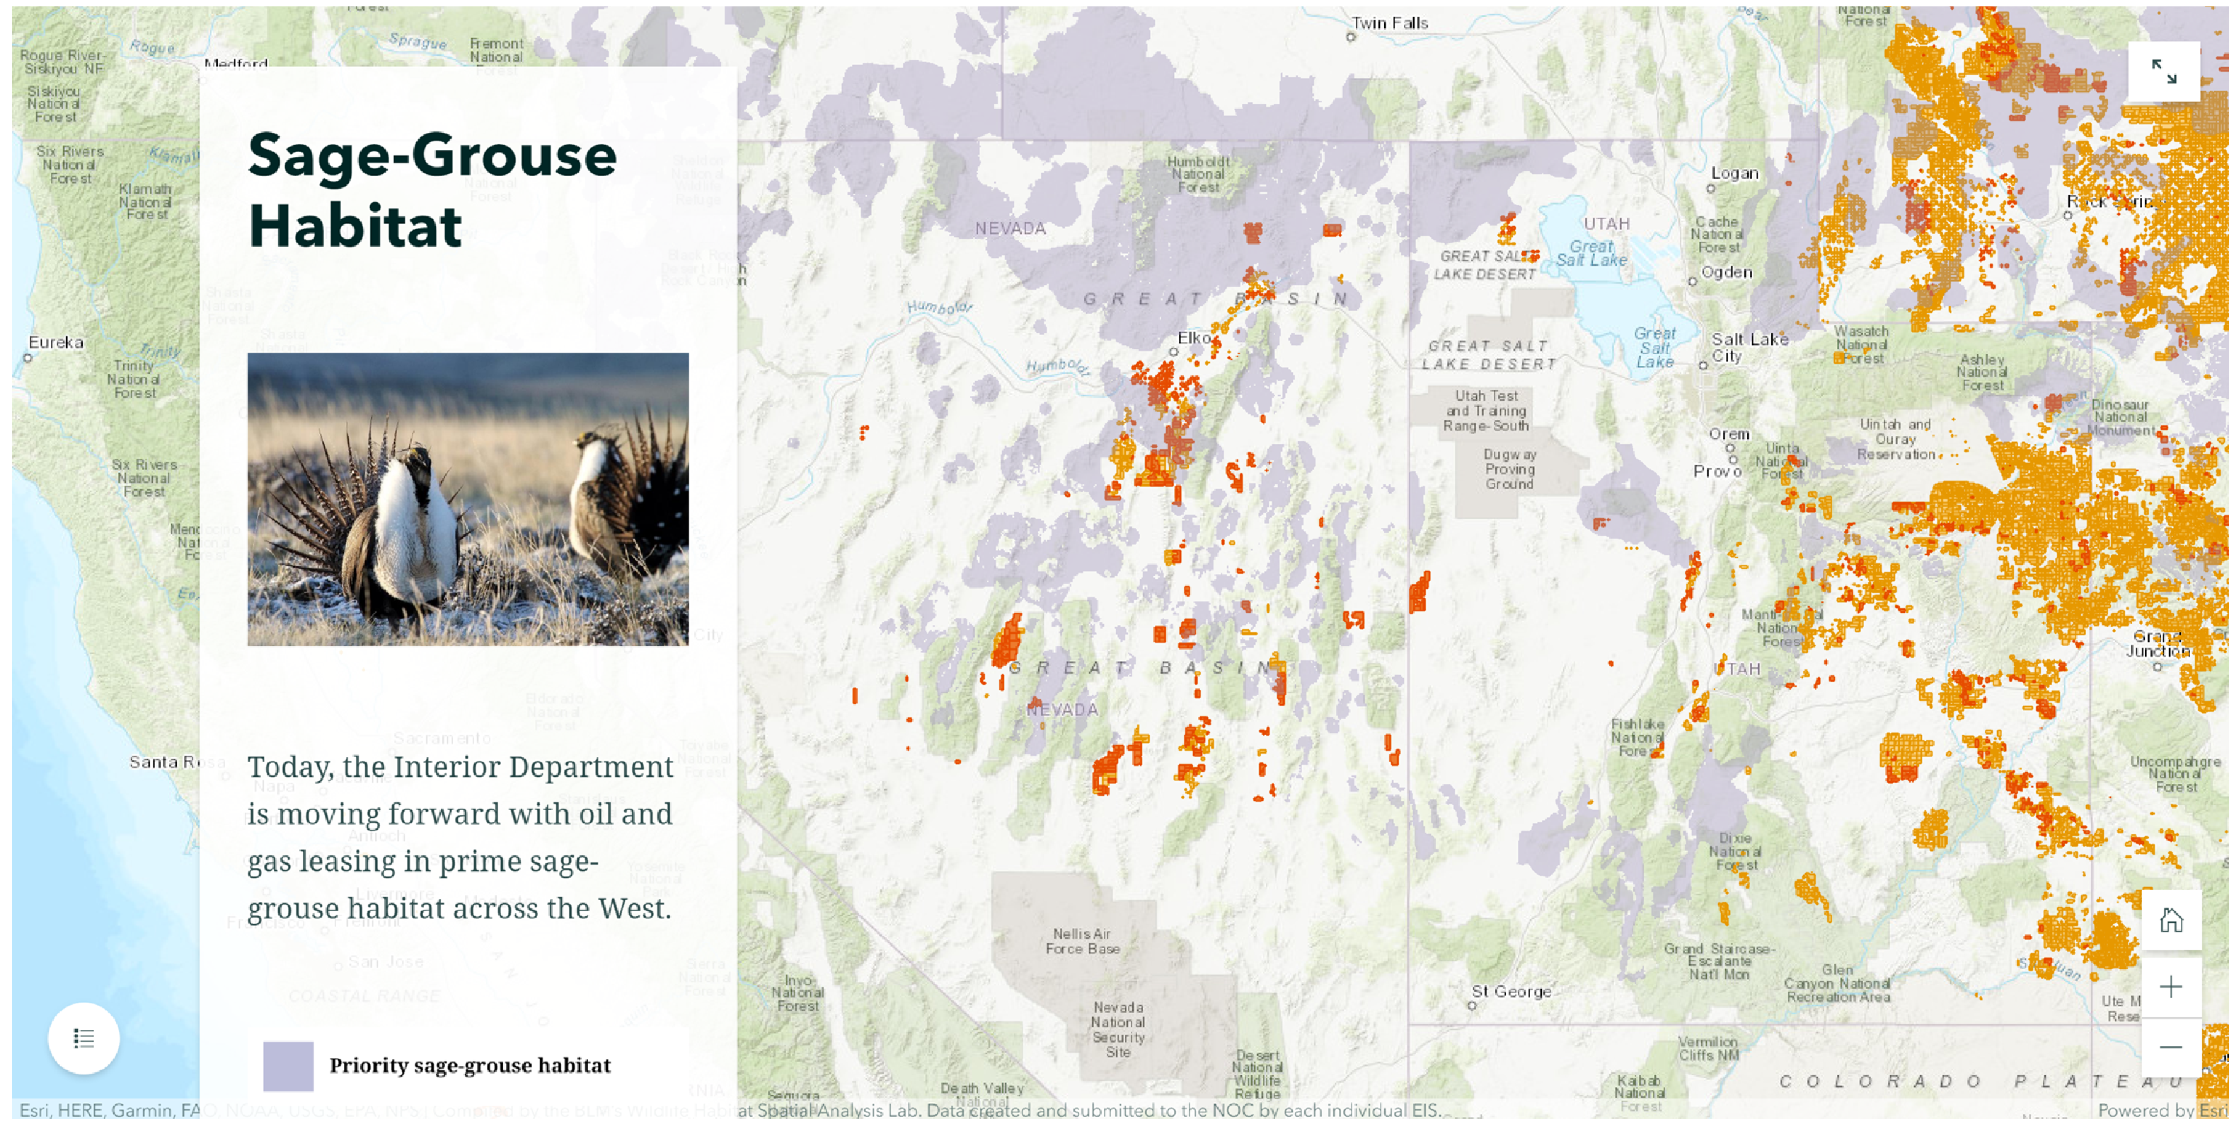
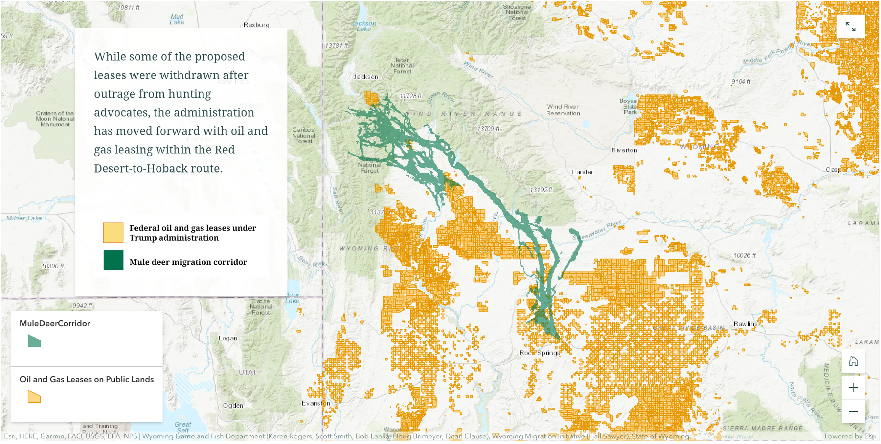
Notes:
The distribution of national parks, monuments, conservation areas, and wilderness areas
The distribution of sage-grouse habitat
The distribution of federal oil and gas leases under Trump administration
The mule deer migration corridor

Slide 8
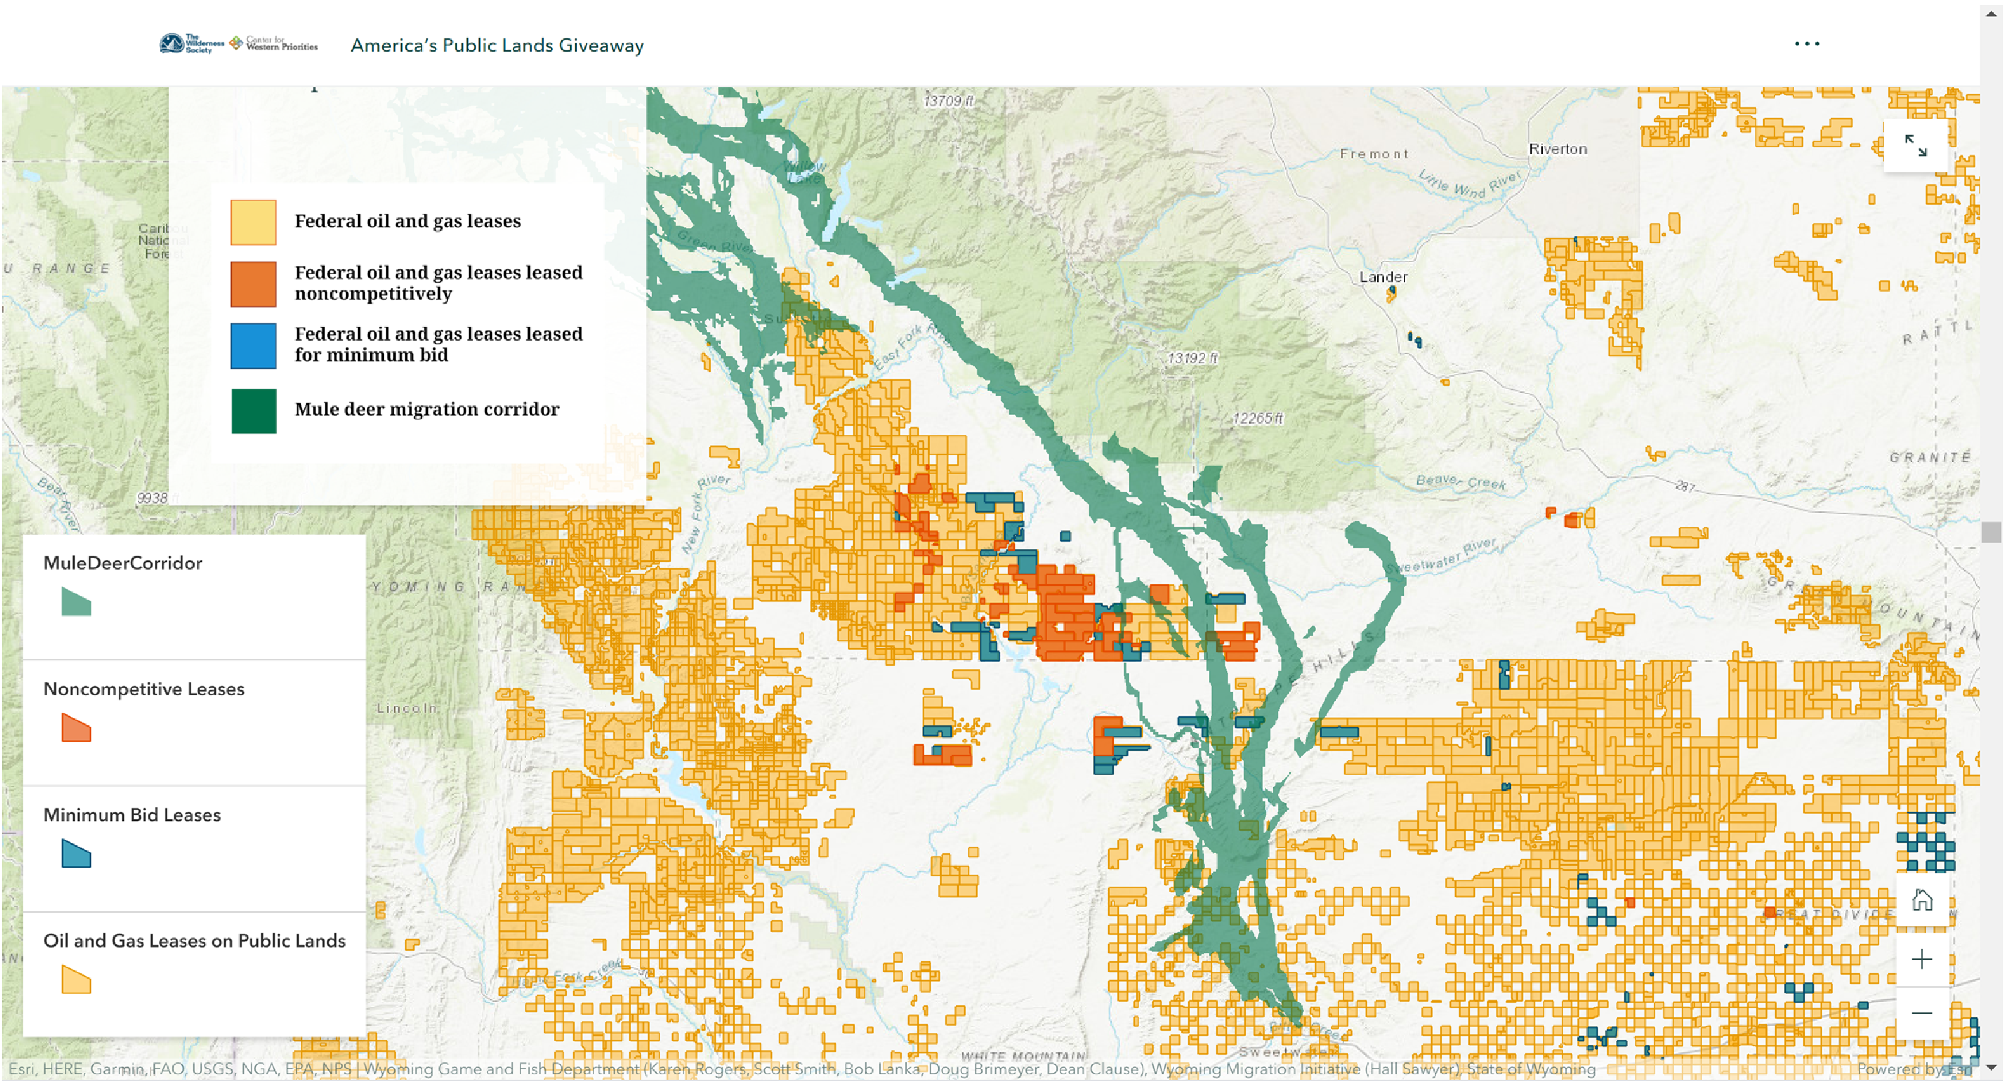
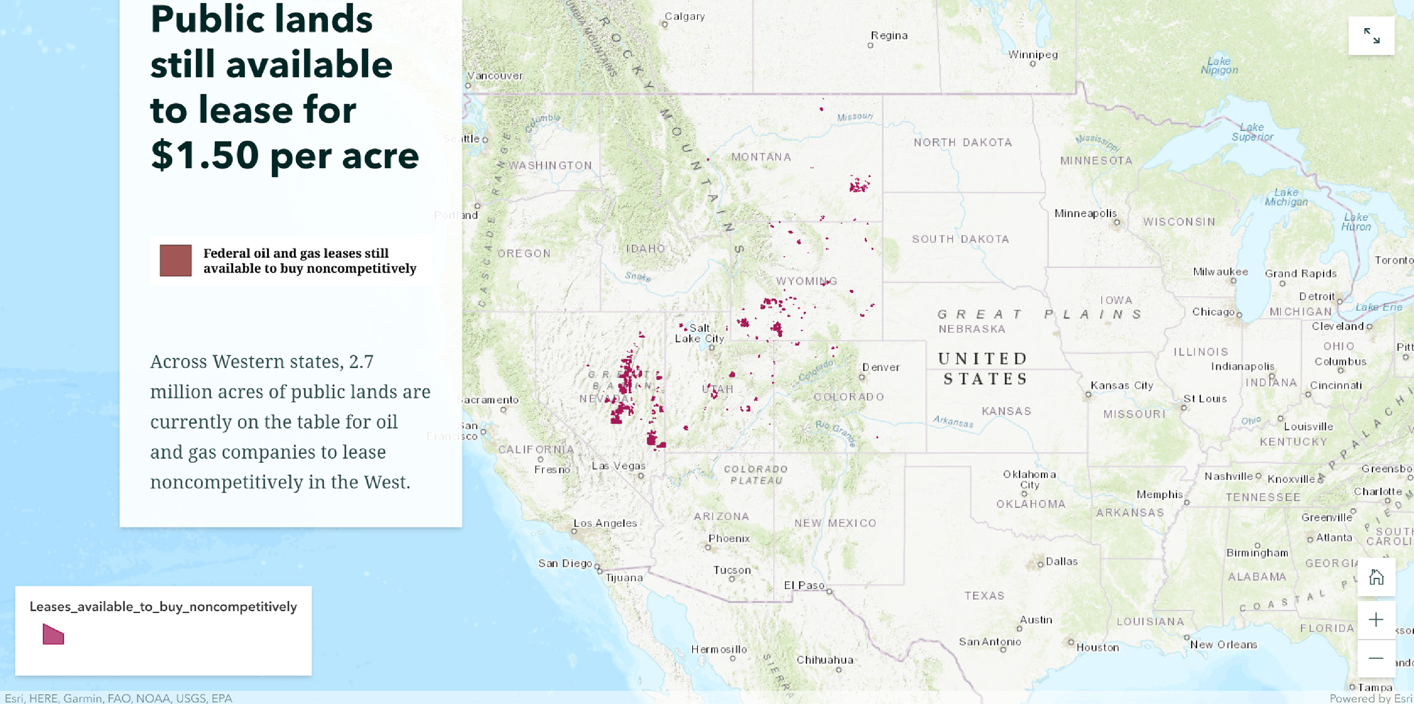

Slide 9
